Slide 1
Using APIs for Psychological Research
The Youtube API
Niklas Cypris
cypris@uni-wuppertal.de
@ncypris

Slide 2


API vs. Scraping
Bearas, CC BY-SA 4.0 via Wikimedia Commons
Bild von photoroyalty auf Freepik

Slide 3
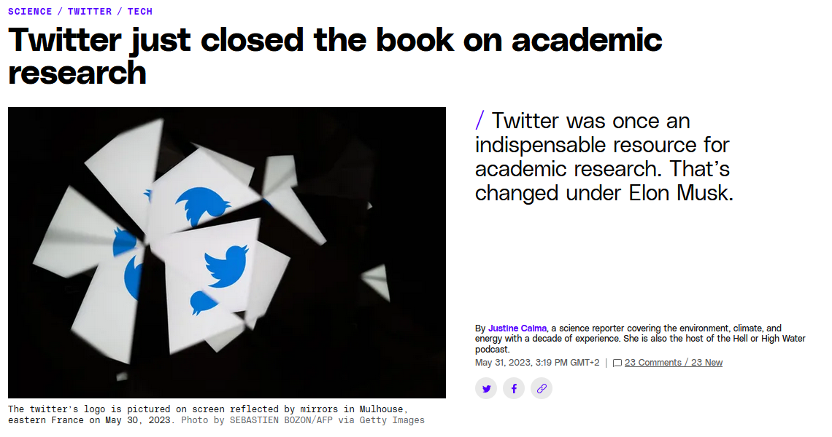
A cautionary tale: Twitter/X
https://www.theverge.com/2023/5/31/23739084/twitter-elon-musk-api-policy-chilling-academic-research

Slide 4
Current APIs (examples)
Facebook Ad Library
Google News
Google Trends
MediaWiki Action
Reddit
Spotify
Youtube
https://bookdown.org/paul/apis_for_social_scientists/
Notes:
https://bookdown.org/paul/apis_for_social_scientists/

Slide 5
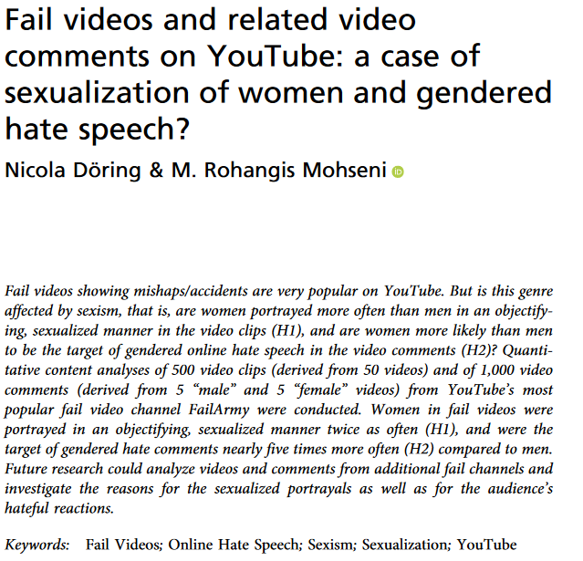
Youtube API in Research
https://www.tandfonline.com/doi/full/10.1080/08824096.2019.1634533

Slide 6
Setting up the API
GESIS Youtube API Workshop - Johannes Breuer
Amazing resource for further reading after our workshop
GESIS trainings highly recommendable

Slide 7

Another cautionary tale: Keys
Bild von vector4stock auf Freepik

Slide 8
Getting started with data collection
Let’s switch to the hands-on practice.

Slide 9
Quotas
Costs = Query Cost * Number of Results
https://developers.google.com/youtube/v3/determine_quota_cost
For comments: 100 results per page
Checking your API Quota - Google Developer Console
APIs & Services (APIs & Dienste)
Enabled APIs & Services (Aktivierte APIs & Dienste): Select the YouTube Data API v3
Select Quotas/Kontingente
Numbers do not update instantly after the calls.

